Slide 1



The role of ICAO and the CORSIA for
International aviation Carbon Neutrality
F4F
Fit4Foresight - Fuel
Prof. M. Prussi

Slide 2



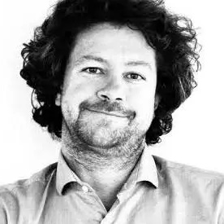



Core Team
Prof. David Chiaramonti
Prof. Carlo Cambini
Prof. Matteo Prussi
Dr. Michel Noussan
Dr. Flavio Pino
Dr. Giacomo Talluri
Dr. Viviana Negro

Slide 3

ICAO environment
Where international aviation is heading at

Slide 4
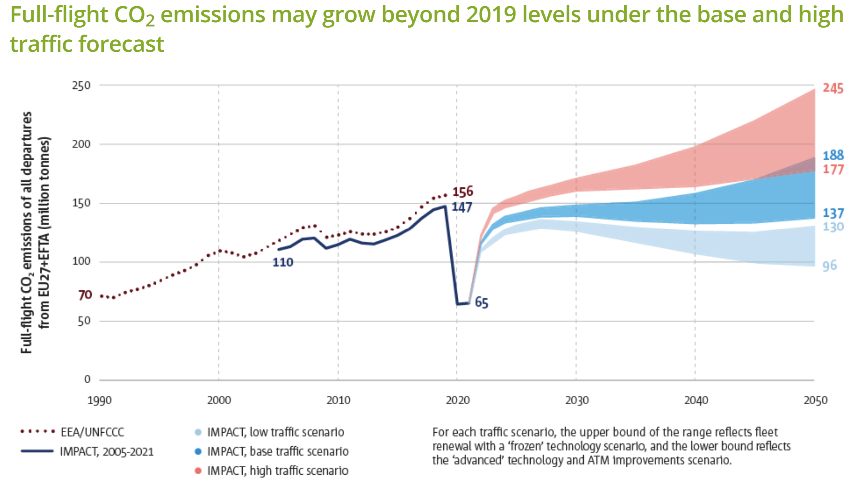
Setting the scene: the need for acting
Before COVID pandemic, international civil aviation was consuming about 160 megatons (Mt) of fuel, corresponding to approximately 2.6% of GHG emissions from fossil fuel combustion.
The sector was growing at a significant pace: before the COVID-19 crisis, ICAO forecasted that by 2050 international aviation emissions could triple compared with 2015.
https://www.easa.europa.eu/eco/eaer/topics/overview-aviation-sector/emissions#emissions-grew-steadily-between-2013-and-2019-and-may
https://www.icao.int/environmental-protection/Documents/EnvironmentalReports/2019/ENVReport2019_pg17-23.pdf

Slide 5
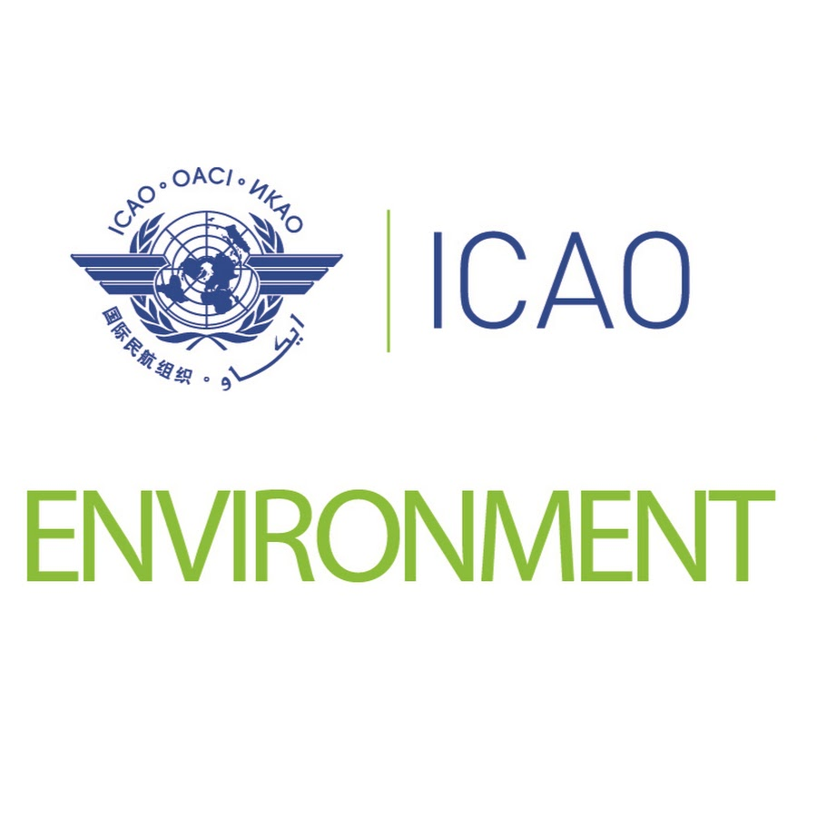
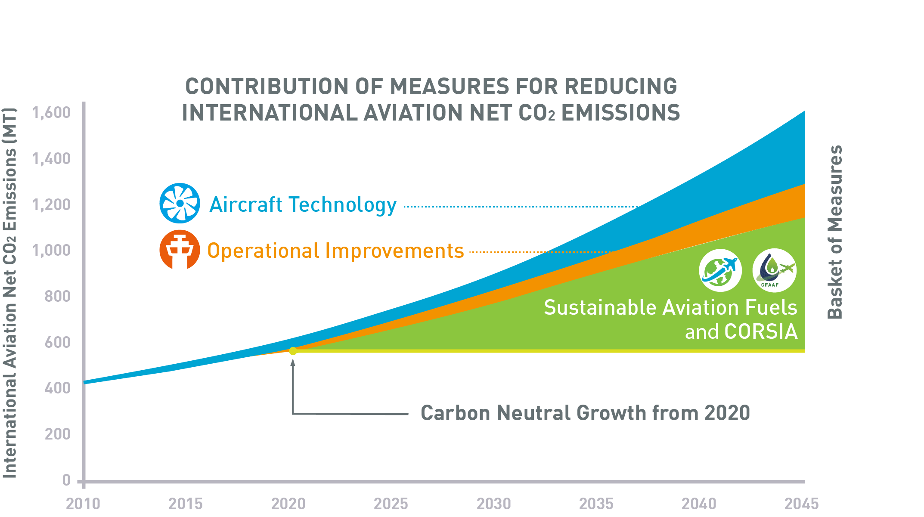
International aviation and climate change
To minimize the adverse effects of international civil aviation on the global climate, ICAO formulates policies, develops and updates Standards and Recommended Practices (SARPs) on aircraft emissions, and conducts outreach activities.
These activities are conducted by the Secretariat and the Committee on Aviation and Environmental Protection (CAEP).
The ICAO Assembly at its 41st Session in 2022
adopted Resolution A41-21 :
  This adopted the collective long-term global aspirational goal for international aviation (LTAG) of net-zero carbon emissions by 2050.
  and market-based measures (CORSIA).

Slide 6
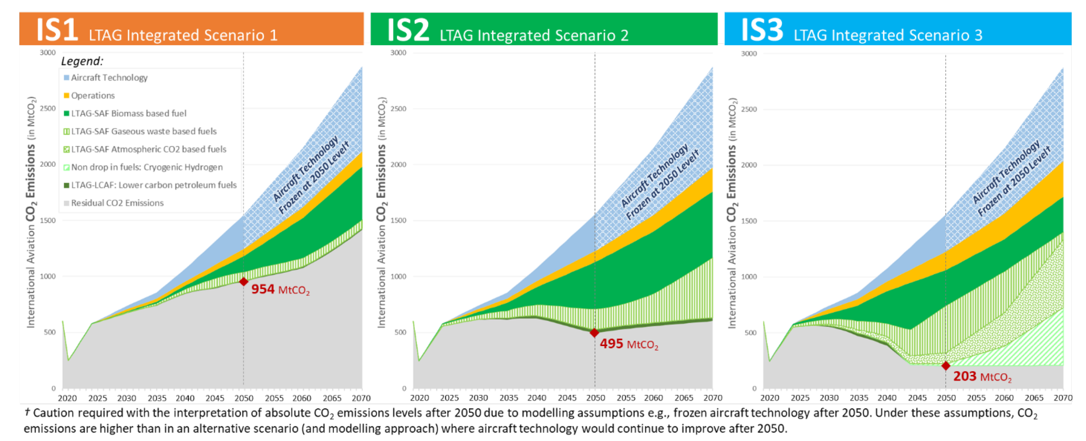
Long term global aspirational goal (LTAG) for international aviation
Aspirations
Three main integrated scenario with increasing aspiration and decreasing readiness and attainability
Drop-in alternative fuels have the largest impact on residual CO2 emissions driving the overall reductions by 2050.
https://www.icao.int/environmental-protection/Pages/LTAG.aspx
From LTAG it is clear the crucial role of SAF
Readiness and attainability

Slide 7
Long term global aspirational goal (LTAG) for international aviation
While the integrated scenarios show the potential for substantial CO2 reduction, none of the scenarios reach zero CO2 emissions using in-sector measures (i.e. technology, operations, and fuels).
This is due to the consideration of fuels’ life cycle emissions and occurs despite a 100% replacement of conventional jet fuel with novel fuels e.g. Sustainable Aviation Fuel (SAF)-biomass, waste or atmospheric CO2 based fuels or hydrogen.
https://www.icao.int/environmental-protection/Pages/LTAG.aspx

Slide 8

Carbon Offsetting and Reduction Scheme for International Aviation (CORSIA)
CORSIA is the first global market-based measure for any sector
Aims at harmonise the way to reduce emissions from international aviation, minimizing market distortion
CORSIA complements the other elements of the basket of measures by offsetting the amount of CO2 emissions (i.e. the use of technological improvements, operational improvements, and sustainable aviation fuels with emissions units from the carbon market).
For the first two phases (2021-2026), participation is voluntary.
From 2027 onwards, participation will be determined based
on 2018 RTK data.
Pilot phase (2021-2023)
First phase (2024-2026)
Second phase (2027-2035)
As of 2024, 126 States participate in CORSIA, from 1 January 2025, bringing the total number of participating States to 129.

Slide 9

What is a CEF
The concept of Sustainability in CORSIA

Slide 10
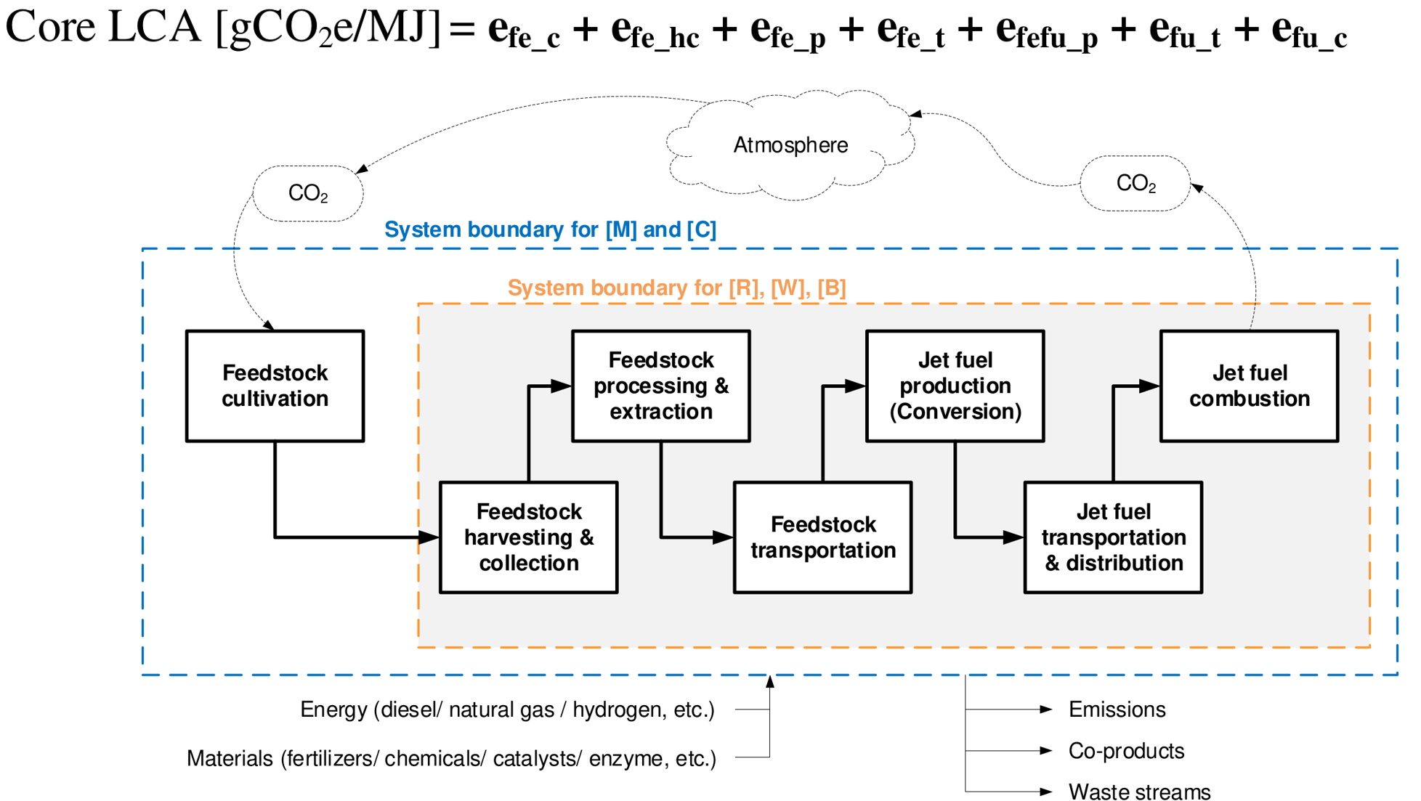
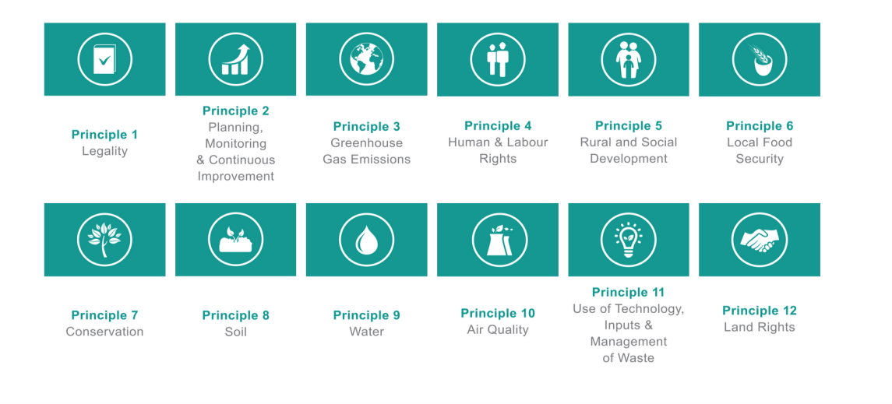

What is a SAF in the ICAO context?
CORSIA Eligible Fuels (CEF):
  SAF: Sustainable Aviation Fuels are defined as renewable or waste-derived aviation fuels that meets the CORSIA Sustainability Criteria.
  LCAF: Lower Carbon Aviation Fuels are defined as a fossil-based aviation fuel that meets the CORSIA Sustainability Criteria.
CEF shall provide environmental benefits in terms of a net CO2 reduction of at least 10% compared to the baseline fossil kerosene (equal to 89 gCO2e/MJ for jet fuel).
Prussi, Matteo, et al. "CORSIA: The first internationally adopted approach to calculate life-cycle GHG emissions for aviation fuels." Renewable and Sustainable Energy Reviews 150 (2021): 111398.
https://rsb.org/rsb-corsia-certification/

Slide 11
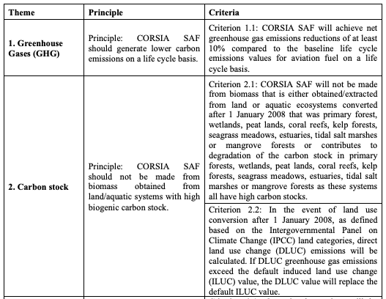
What is sustainability about?
Notes:
Baseline = referencia

Slide 12
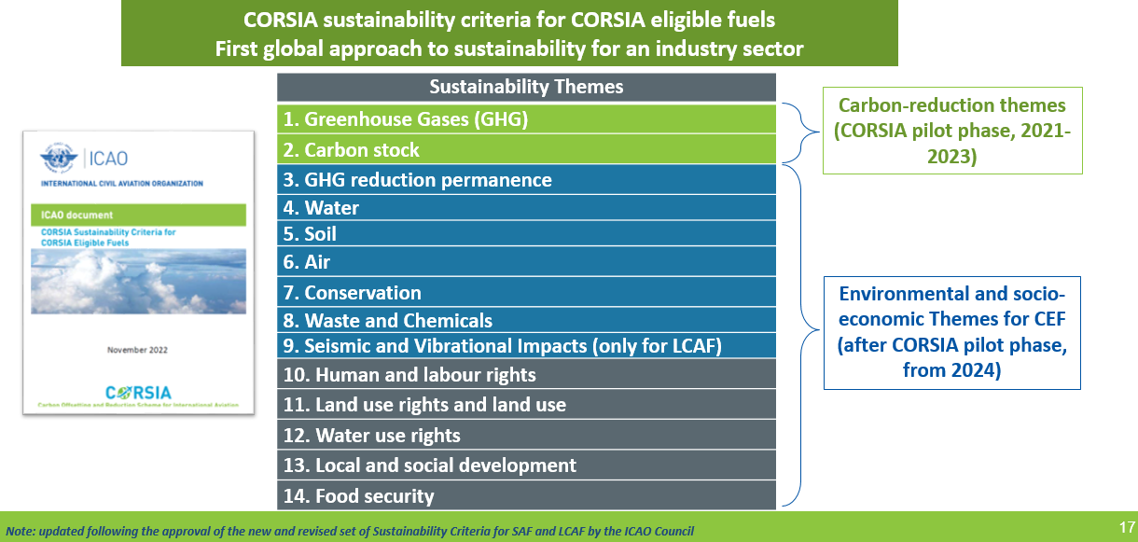
Fuente:Presentación de la OACI “Introducción a los combustibles de aviación sostenibles”, serie ACT-SAFn1
* NOTA:En el momento de la presentación de la serie ACT-SAF n.° 1 en noviembre de 2022, los criterios de sostenibilidad para el LCAF estaban siendo analizados por el Consejo de la OACI. Desde entonces, se han aprobado y están disponibles en el sitio web de la OACI.

Slide 13
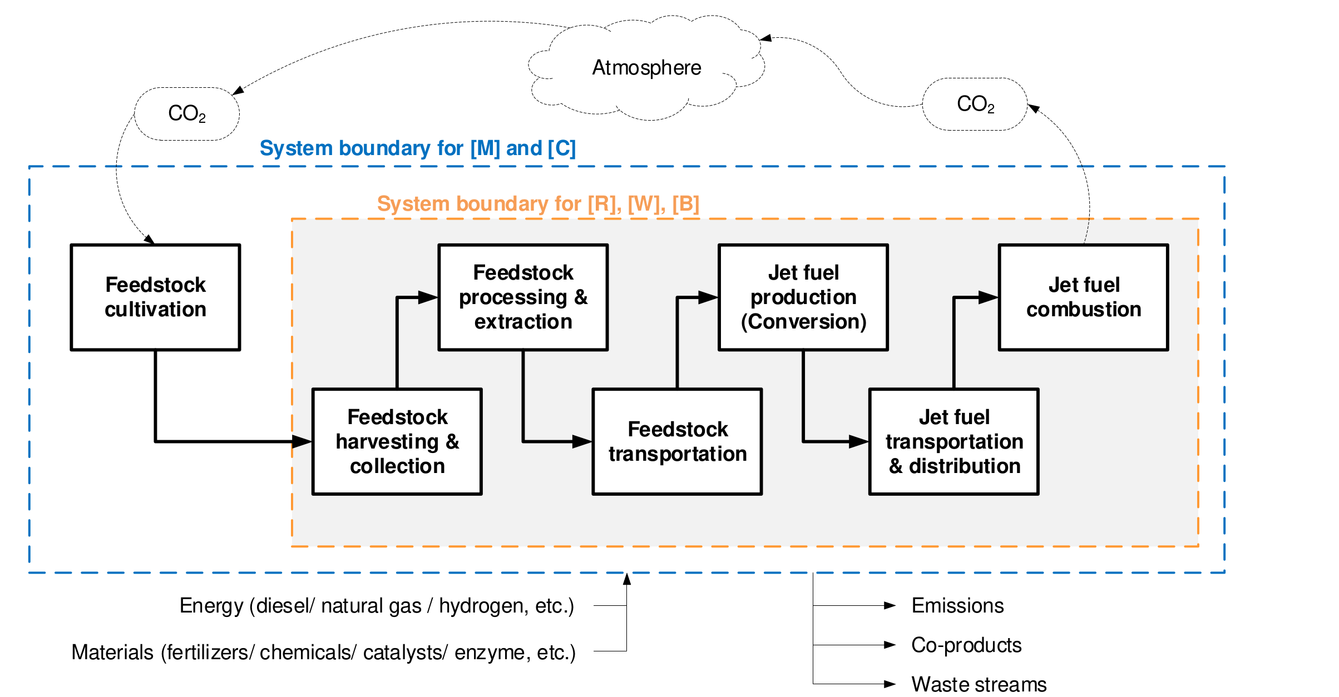
GHG accounting
Prussi, Matteo, et al. "CORSIA: The first internationally adopted approach to calculate life-cycle GHG emissions for aviation fuels." Renewable and Sustainable Energy Reviews 150 (2021): 111398.

Slide 14
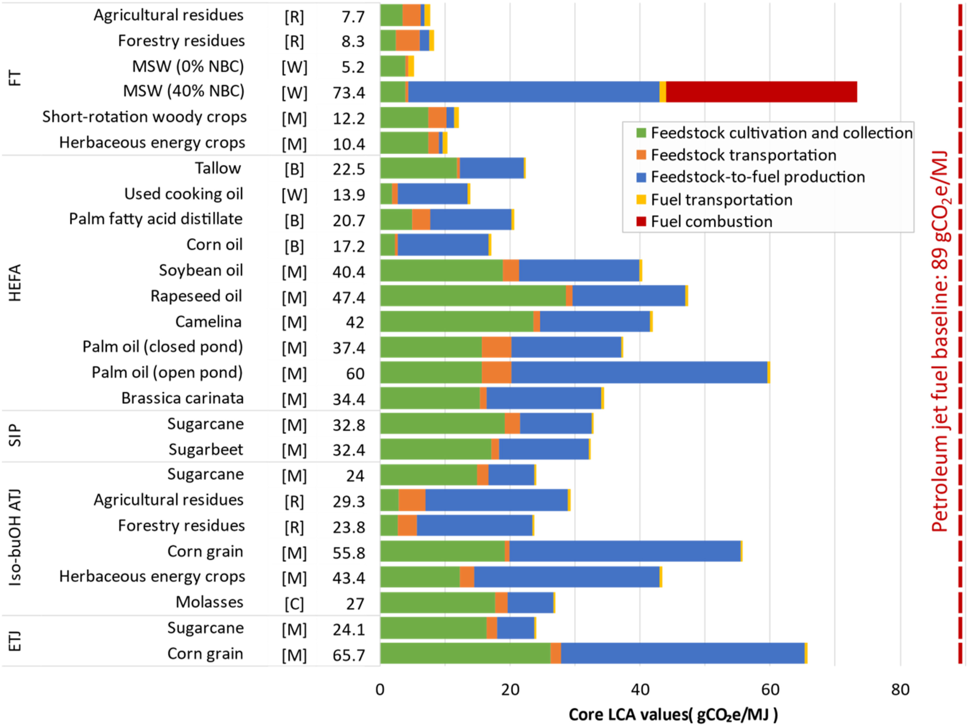
CORSIA methodology
Prussi, Matteo, et al. "CORSIA: The first internationally adopted approach to calculate life-cycle GHG emissions for aviation fuels." Renewable and Sustainable Energy Reviews 150 (2021): 111398.

Slide 15
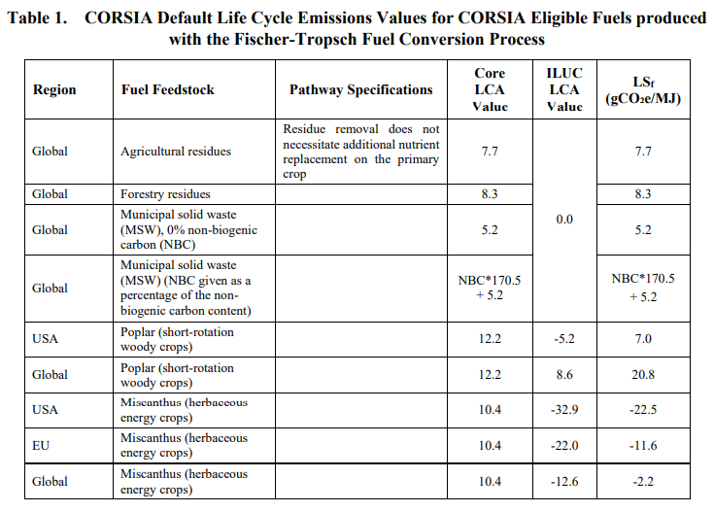
Default life cycle emissions values
Core Default LCA values depend on:
feedstock
conversion process
pathway specification
Region is only relevant to ILUC values
https://www.icao.int/environmental-protection/CORSIA/Documents/CORSIA_Eligible_Fuels/ICAO%20document%2006%20-%20Default%20Life%20Cycle%20Emissions%20-%20March%202024.pdf

Slide 16
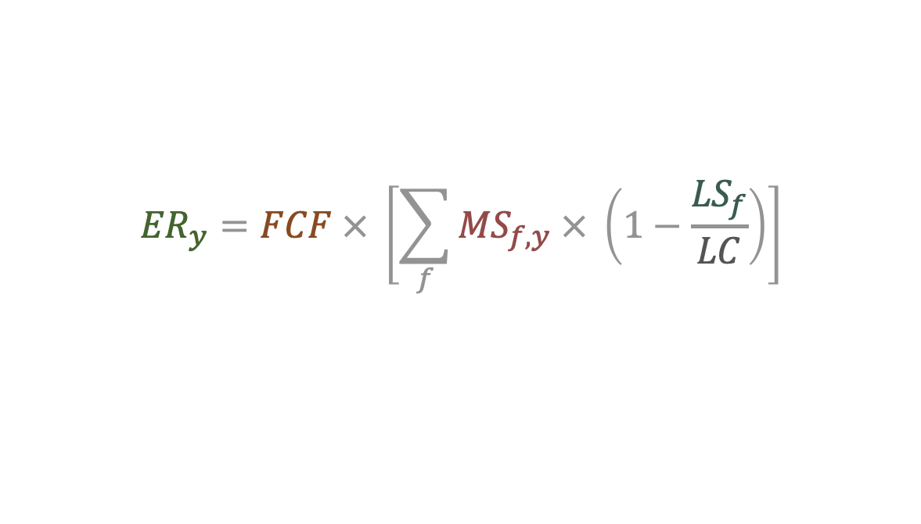
The crediting formula: every grams count!
Fuel Conversion Factor:
fixed value: 3.16 for jet fuel, 3.10 for AvGas (kg CO₂ / kg fuel)
Lifecycle emissions value for CEF type
(actual or default)
L_{CEF}
Emissions reduction
in year y
Baseline life cycle emissions:
89 g for jet fuel, 95 for avgas (gCO_{2e}/MJ)
Total Mass of CEF claimed
in year y, by fuel type f
The reduction of offsetting obligations from the use of SAF scales with the life-cycle GHG emissions benefit per unit SAF, and with the amount of SAF used.
Notes:
Formula de calculo de esta reduccion total

Slide 17

Sustainability in practice
How SCS is implemented in CORSIA

Slide 18
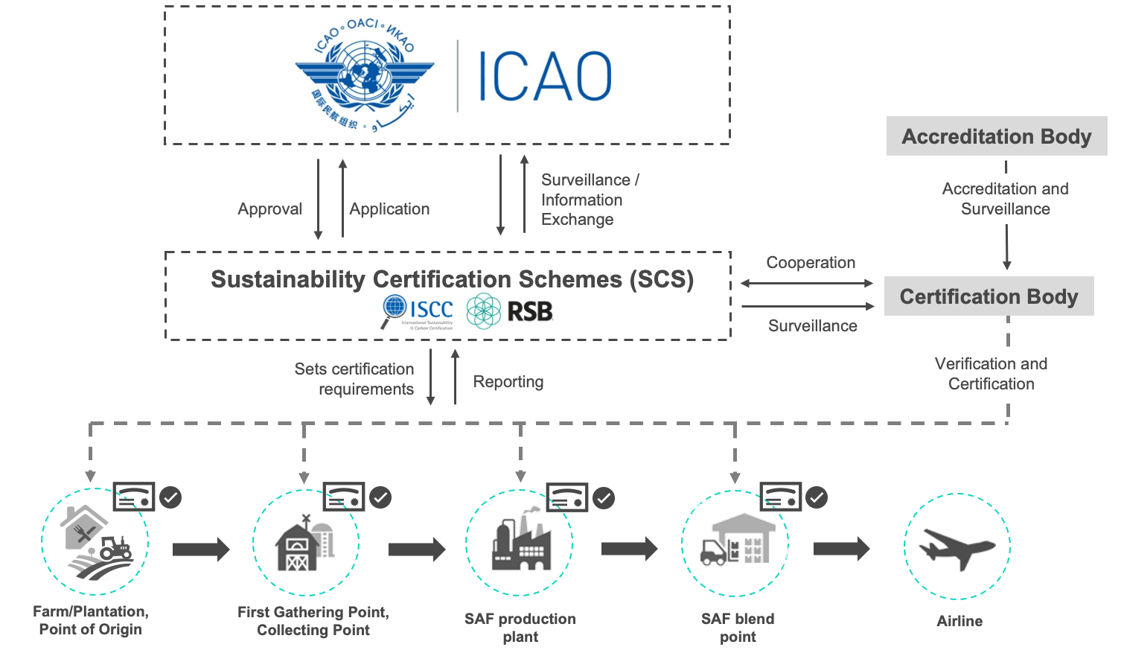
The certification process
Notes:
Esquema de certificacion de sostenibilidad
El reconocimiento por OACI de SCS
Organismos certificadores

Slide 19
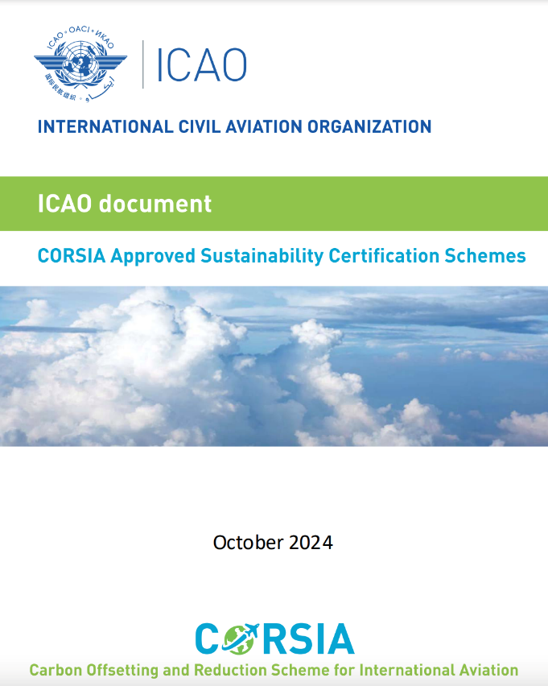
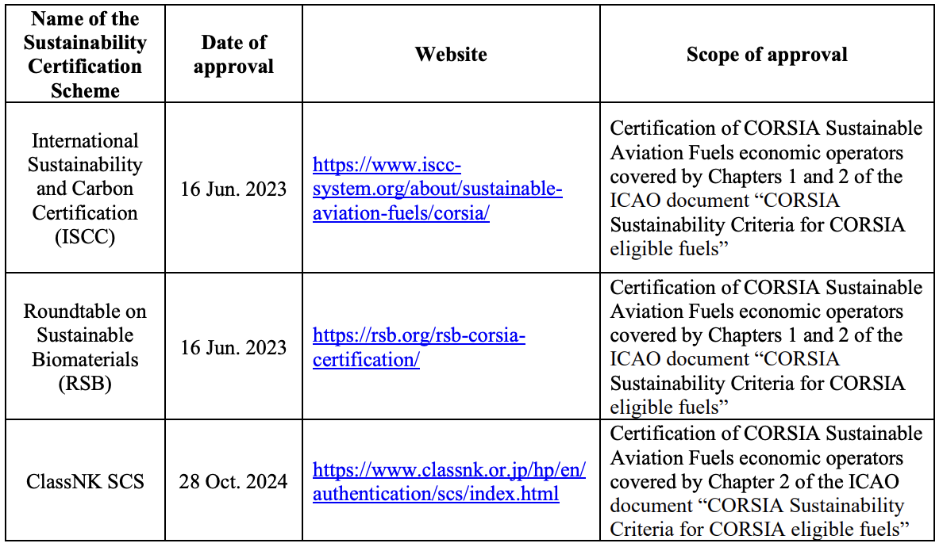
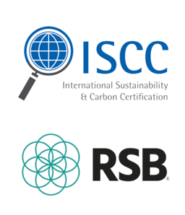


SCS currently approved by ICAO
The ICAO Council has adopted the sustainability certification requirements (SCS) to certify eligible fuels under CORSIA (CEF)

Slide 20

Conclusions

Slide 21
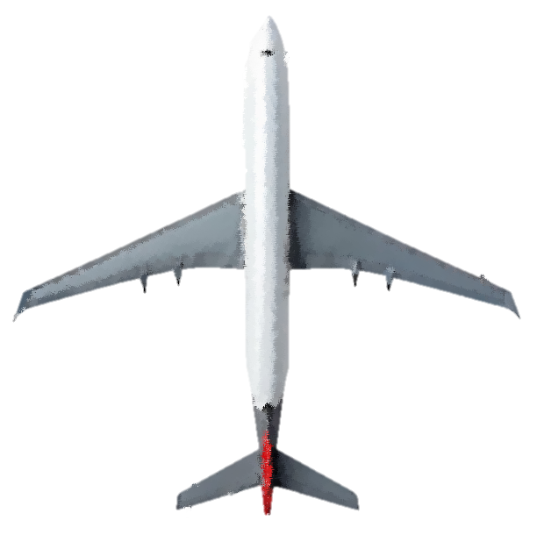
Conclusions
Aviation has been recovering very fast from COVID-19 pandemic => with a significant associated environmental impact.
Aviation is expected to rely on liquid fuels in the short-medium term, especially for the long-haul flights.
Sustainable Aviation Fuels are considered an effective tool for sector decarbonisation.
SAFs as defined in CORSIA can reduce life-cycle GHG emissions (by over 90%).
CORSIA has established a framework and approved SCS to allow operators to use SAF for decarbonising international aviation.

Slide 22

Thanks for your attention!
Matteo Prussi
Politecnico di Torino
matteo.prussi@polito.it
22

Slide 23

Themes and principles about GHG
Theme 1: Greenhouse gases
Theme 2: Carbon stock
CORSIA eligible fuel should generate lower carbon emissions on a life cycle basis
CORSIA eligible fuel should not be made from biomass obtained from land with high carbon stock
Link
Notes:
Carbon stock = reservas de carbono

Slide 24
Themes and principles about environment
Theme 3: GHG emissions reductions permanence
Theme 4: Water
Theme 5: Soil
Theme 6: Air
Theme 8: Waste and chemicals
Theme 9: Seismic and Vibrational Impacts (applicable to LCAF only)
Theme 7: Conservation
Emissions reductions attributed to CORSIA CEF should be permanent.
Production of CORSIA CEF should maintain or enhance water quality and availability
Production of CORSIA CEF should maintain or enhance soil health
Production of CORSIA CEF should minimize negative effects on air quality
Production of CORSIA CEF should maintain biodiversity, conservation value and ecosystem services
Production of CORSIA CEF should promote responsible management of waste and use of chemicals
Production of CORSIA LCAF should minimize seismic, acoustic, and vibrational impacts
Notes:
Wastes = residuos
Sfecto sismico

Slide 25
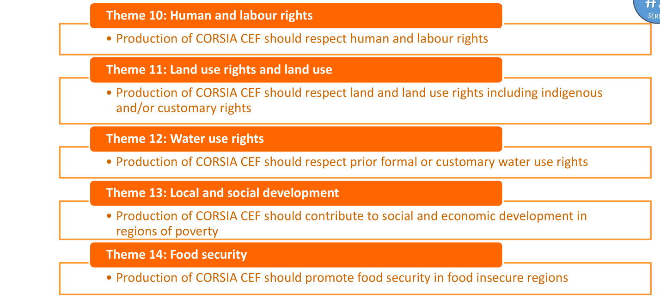
Temas y principios socioeconómicos
Nota: actualizado tras la aprobación del nuevo y revisado conjunto de criterios de sostenibilidad para SAF y LCAF por parte del Consejo de la OACI
Notes:
Derechos laborales
Seguridad alimentaria

