Slide 1
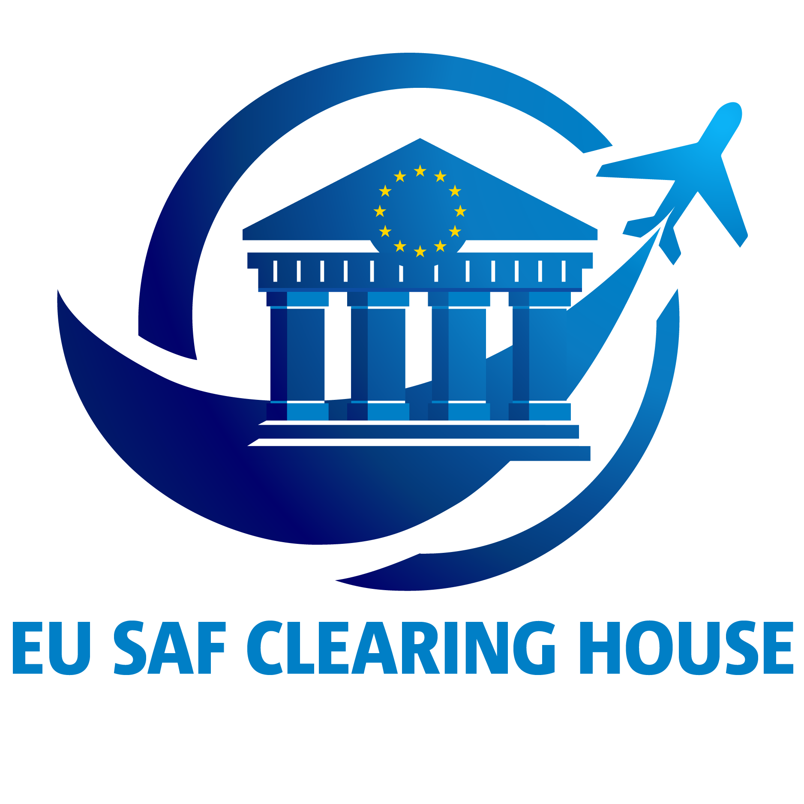
Status, Challenges and Opportunities in EU SAF Deployment from the Vantage Point of the EU SAF Clearing House
Professor Stephen Dooley,
Director of the EU SAF Clearing House & Trinity College Dublin

Slide 2
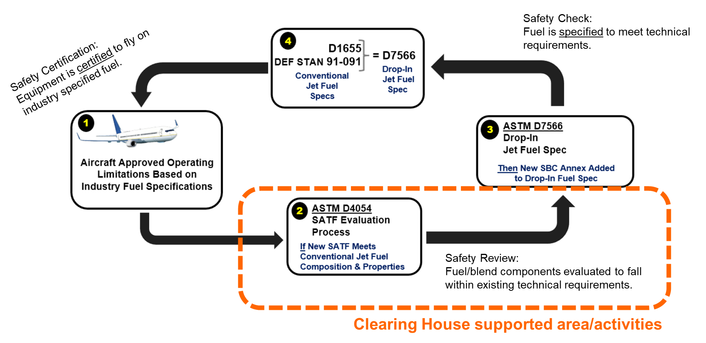
What is a Sustainable Aviation Fuel Really?
Criteria #1: Fuel Technical Quality (“ASTM International”).

Slide 3
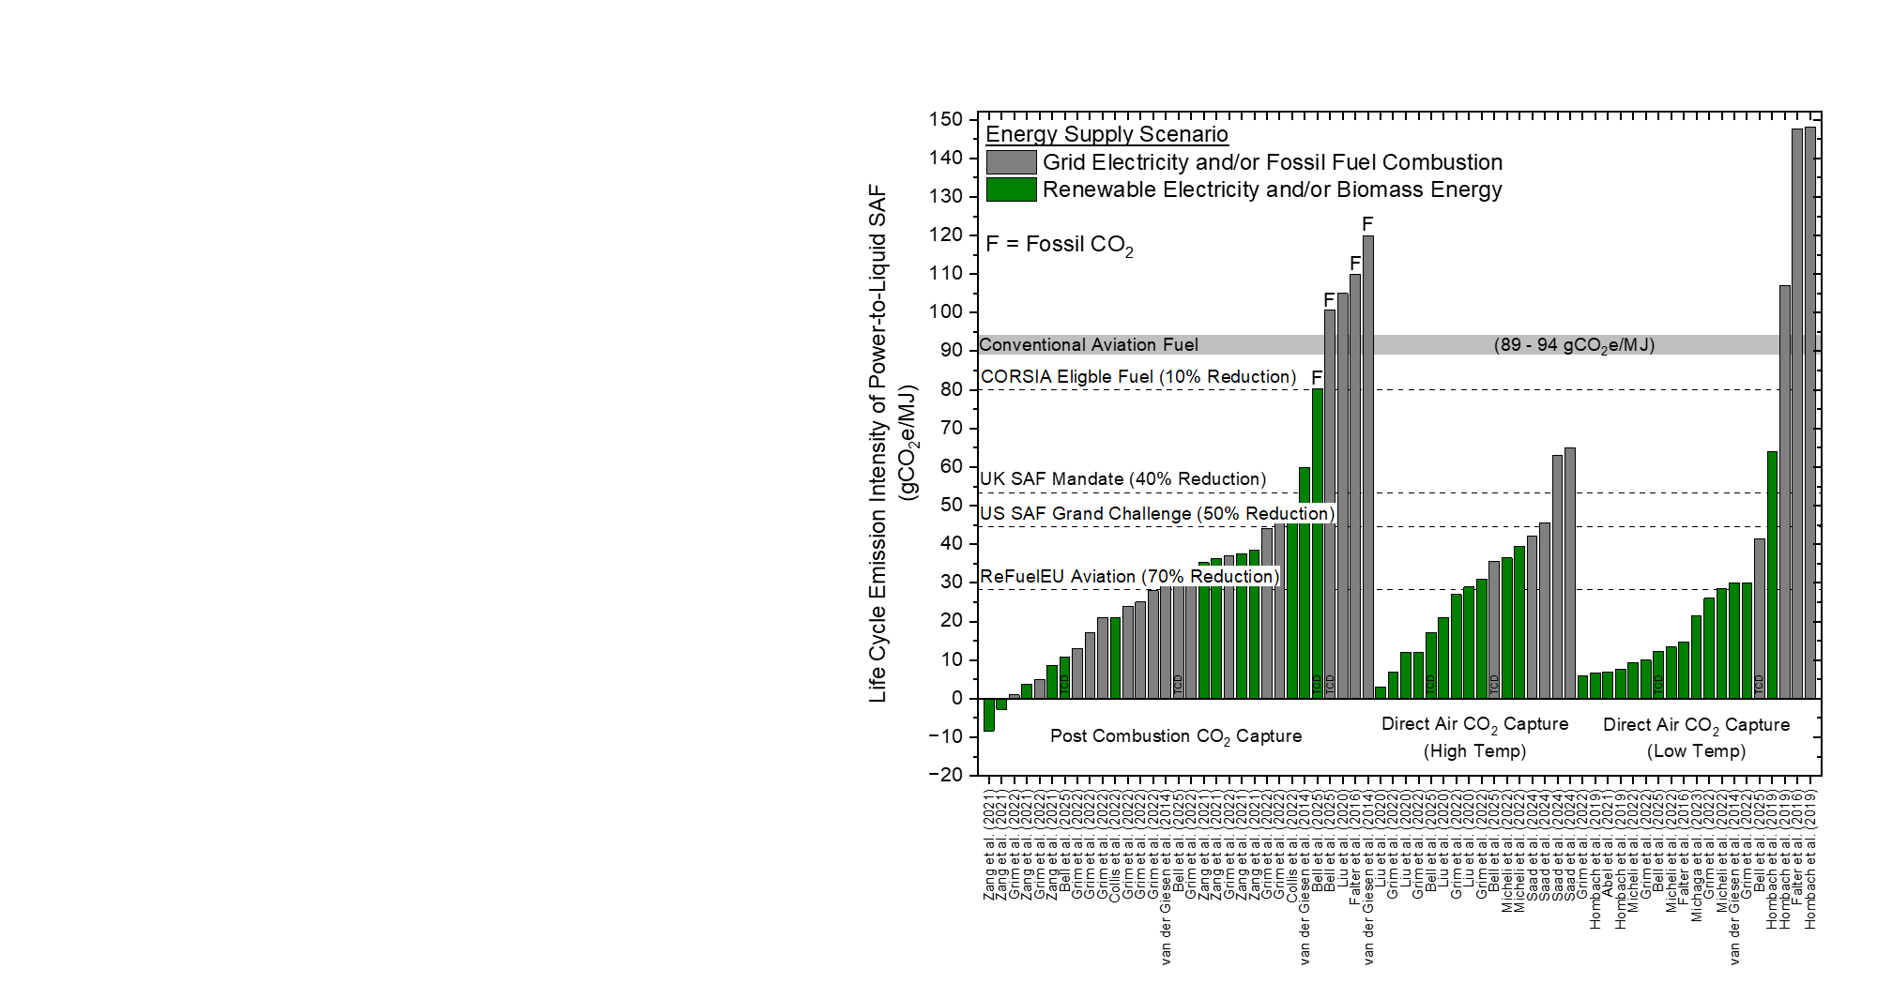
What is a Sustainable Aviation Fuel Really?
Criteria #2: “Sustainability Certification”
ISCC, RED III, RSB.
For EU: 70% CO_{2(eq)} saving relative to conventional aviation fuel is required.
On site renewable and/or Bioenergy is required for most scenarios.

Slide 4
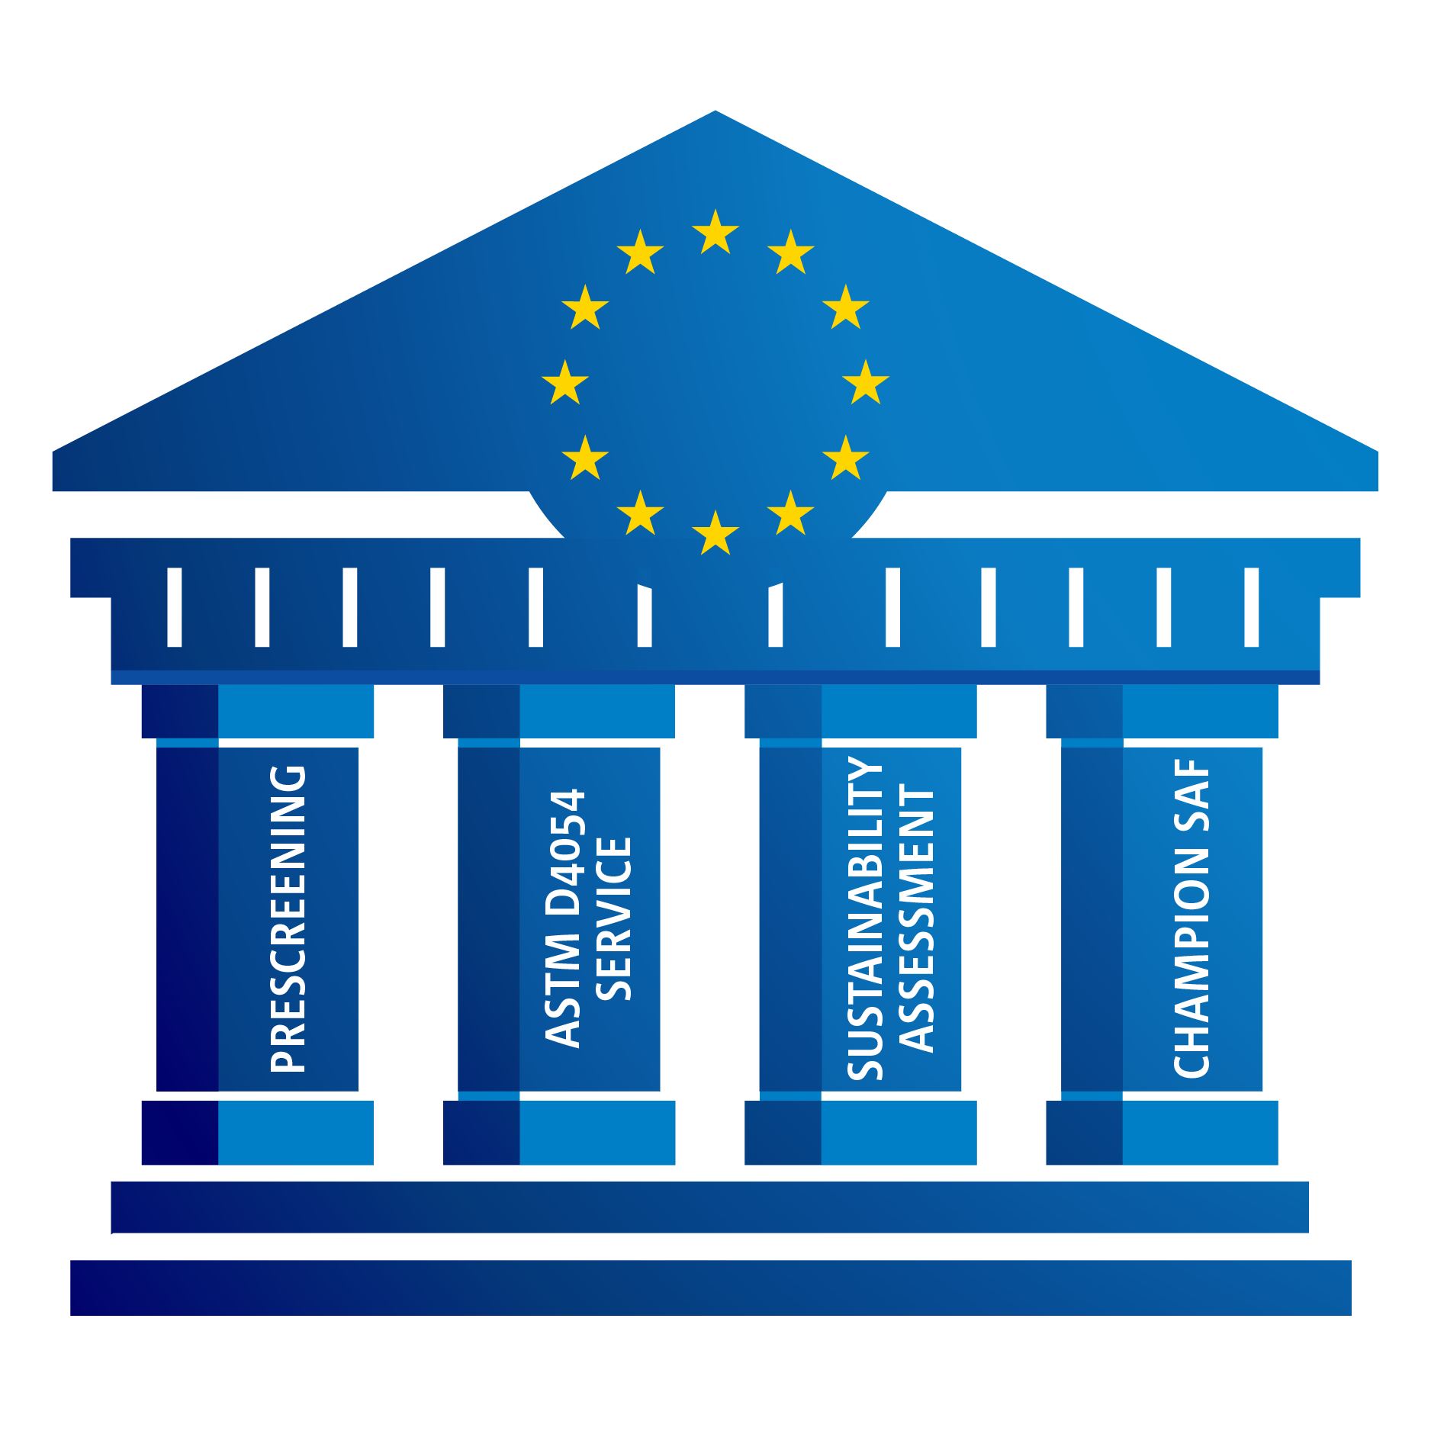
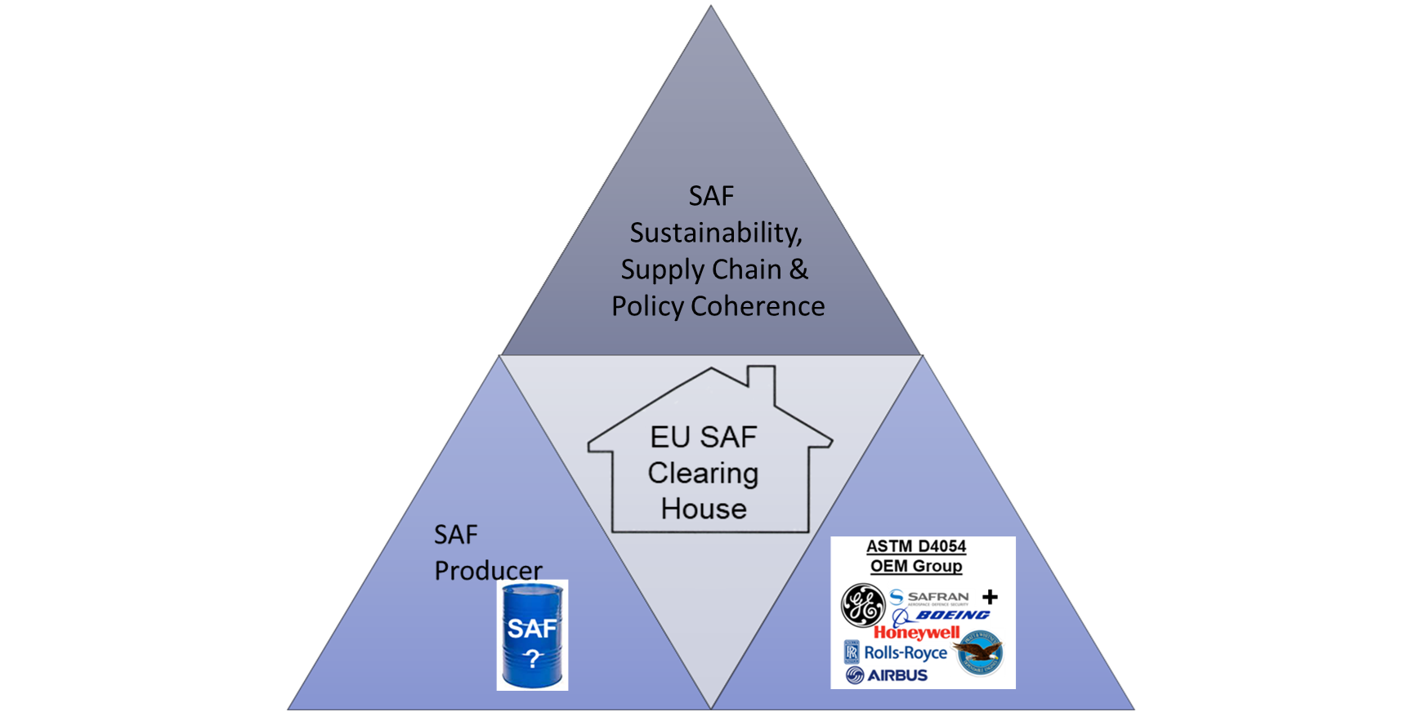
EU SAF Clearing House Concept: Lowering Barriers Faced by All with Expert Led Services
Launch: Q3 2023, Ricardo B.V. Nederland.
Director: Prof. Stephen Dooley, Trinity College Dublin.
Project Manager: Andreas Busa, EASA.
info@eusafclearinghouse.eu
stephen.dooley@tcd.ie
andreas.busa@easa.europa.eu
www.eusafclearinghouse.eu
2025 EU SAF Clearing House Clients:
10 SATF Producers/Technology Developers are enrolled.
Prescreening reports are being issued.

Slide 5
2025 Status of New SAFs
New Feedstock, or New Process, or New SAF product means OEM approval (ASTM D4054).
New synthetic blend component and/or New synthetic aviation turbine fuel.
Marathon (formerly Virent) (USA) – synthesized aromatic kerosene (SAK)
Feedstock: commercial sugars | Process: hydrodeoxygenation.
CSIR-IIP (India) – synthesized kerosene with aromatics (SKA)
Feedstock: FOG | Process: adapted HEFA.
ExxonMobil/Honeywell UOP (USA) – Methanol-to-Jet (MTJ)
Feedstock: Methanol | Process: dehydrogenation + oligomerization.
Halder-Topsoe (Denmark) – Methanol-to-Jet (MTJ)
Feedstock: Methanol | Process: dehydrogenation + oligomerization.
OMV ReOil (Austria) – synthesized kerosene with aromatics (SKA)
Feedstock: waste plastic | Process: pyrolysis oil + refinery ops
Revo (Japan) – HEFA with higher cycloparaffins.
Feedstock: FOGs | Process: HEFA.
CleanJoule (USA) – synthesized cycloparaffins (SCP)
Feedstock: Isoprene | Process: oligomerization + hydroprocessing.
UPM (Finland) – synthesized kerosene with aromatics (SKA)
Feedstock: Crude Tall Oil (CTO) | Process: hydroprocessing + fractionation.
IH² (USA) – cycloparaffinic kerosene
Feedstock: wood/cellulous | Process: hydropyrolysis + hydroconversion.

Slide 6
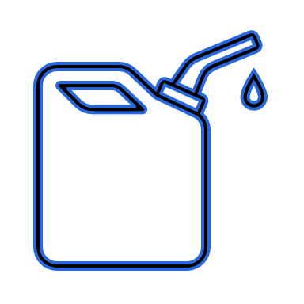
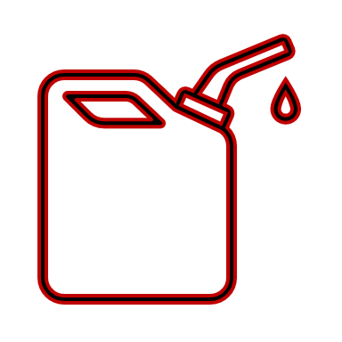
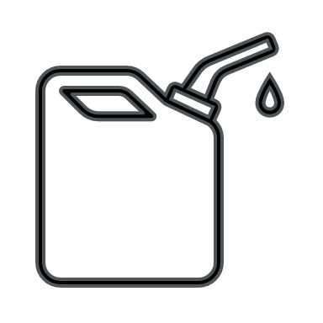
SAF Evaluation Funnel
Prepare Producers.
Provide Reliable Data
Facilitate OEM approval.
Engagement
Training & Guidance
Scaling
New SATF Pathway
Evaluation Process
Are you producing a SAF according to a D7566 Annex or do you require approval for a new SAF type?
Research & Development
Prescreening
D4054 Evaluation
by OEMs
Your processes are similar ,you should form a joint task force and go through evaluation together.

Slide 7
SAF Evaluation Funnel
Prepare Producers.
Provide Reliable Data
Facilitate OEM approval.
Engagement
Training & Guidance
Scaling
New SATF Pathway
Evaluation Process
Are you producing a SAF according to a D7566 Annex or do you require approval for a new SAF type?
Research & Development
Prescreening
You are ready for OEM evaluation.
Yes
D4054 Evaluation
by OEMs
Exit the Clearing House, you are free to produce.
We are not sure?
No
Your processes are similar ,you should form a joint task force and go through evaluation together.
We aim to produce “SAF” but we don’t know anything about the evaluation process
Our fuel might be compatible to a D7566 Annex
We might need to go through the D4054 evaluation

Slide 8
Many Barriers to Scaling SAF - Opportunities
1. Enable
TCD & EU SAF Clearing House Concept: Lower common barriers with expert led centralized services.
SAF Technical Quality Evaluation & Approval
Techno Economic Assessment.
Supply Chain Integrity Assessment.
SAF Sustainability Certification.
Final Investment Decision accelerator.
Centralized syncrude upgrading facilities.
2. New Designs for Scale A + B
A) Feedstocks: Available, energy rich,
hydrogen rich, biogenic carbon:
Lignocellulose.
Sewage sludge.
B) High TRL conversion processes.
Fast pyrolysis.
Hydrothermal liquefaction.
Hydrolysis.
3. Be Smart
Low Carbon Platform Commodities as a lower risk collecting point - hydrogen rich, liquids, multi-use market commodities.
Syngas to SAF
Ethanol to SAF
Methanol to SAF
Formates to SAF?

Slide 9
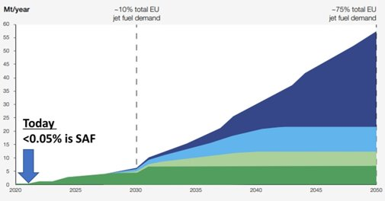
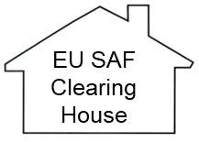
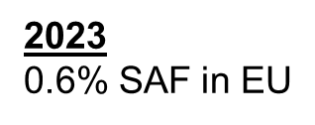
EU SAF Clearing House Concept: Lowering Barriers Faced by All with Expert Led Services
New Technologies? Fast pyrolysis? Hydrothermal liquefaction? CO₂ Electrolysis? Methanol?
Need EU’s 67 refineries to co-process more biocrudes at higher blends
Sustainability Certification?
Business Case & Bankability?
Off-takers?
OEMs Group must approve (allow) all of this
=> testing => data => review => agree => time & €€€.
Need for ~300 SAF plants to ReFuelEU
Need for more new feedstock-to-SAF pathways to be approved for use
New Feedstocks with Supply Chain Hubs? Centralised syncrude upgrading?
100% SAF?
OEM Group
As of Today
8 feedstock-to-SAF pathways &
3 co-processing pathways
Approved in 16 years
14 SAF candidates currently under evaluation, but OEMs can evaluate ~2 per year

Slide 10
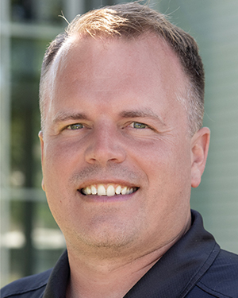
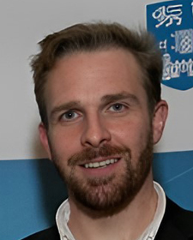
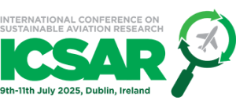
Clearing House Concept Market Intelligence Workshops to Propose Barriers/Solutions
Coordinated International Engagement with EU/US/UK Clearing Houses
Professor Joshua Heyne
Washington State University
US SAF Clearinghouse
Next Workshops:
Sustainable Aviation Futures
@ Amsterdam, May 7.
ICSAR, Dublin July 8-11.
@ SMBC Aviation Capital
Sustainable Aviation Futures
@ Houston October 15.
Professor Stephen Dooley
Professor Mohammad R. Ghaani
Trinity College Dublin
EU SAF Clearinghouse
Collective Action.
2 . Identify Common Barriers.
3. Implement Impactful Solutions Together.
4. Deploy SAF.

Slide 11
Status, Challenges and Opportunities in EU SAF Deployment from the Vantage Point of the EU SAF Clearing House
Professor Stephen Dooley,
Director of the EU SAF Clearing House & Trinity College Dublin

